Slide 1
Digital Electronics and Systems
Topic : Sum of product and Product of sum

Slide 2

Literal
Each appearance of a variable, either uncomplemented
or complemented, is called a literal.
Example:
If A is a variable, then literals are A and
For ‘n’ variable function – No: of literals are 2n
Consider a function f (A,B) = AB+
In this function, no: of variables = 2
Maximum no: of literals = 2n = 4

Slide 3


Representation of Boolean Expression
1. Sum of Product (SOP)
2. Product of Sum (POS)
Product term: Variables are in multiplication format.
Sum term: Variables are in addition format.

Slide 4

Sum of product (SOP)
Adding product terms.
This SOP is not in standard form.
Because in the last product term one variable, B is missing.
Standard form SOP is also known as Canonical SOP.
Each individual term in standard SOP is called as minterm.

Slide 5

For SOP / minterm
‘0’ corresponds to complemented variable
‘1’ corresponds to normal variable.
Consider the function,
It consists of 3 variables – A , B & C
General equation for finding number of possible combinations = 2^{n}
n = no: of variables
For 3 variables , no: of combinations = 2³ = 8

Slide 6
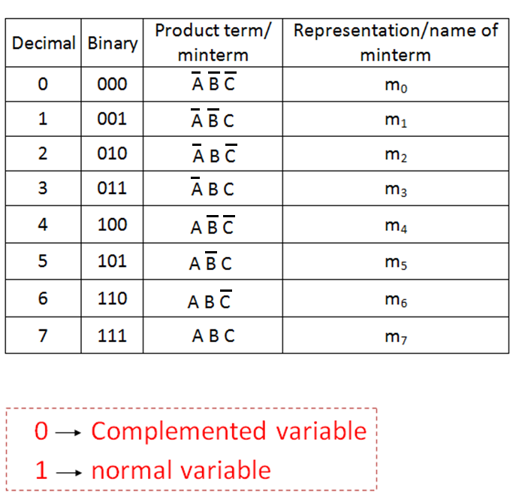

Slide 7

Based on this truth table
can be written as:
f = m₃ + m₅ + m₆ + m₄
This is the alternate representation of standard SOP.
It can also be represented as

Slide 8
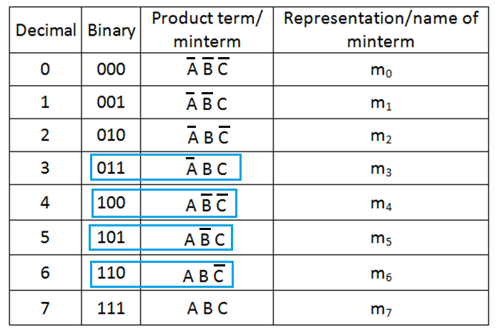
(1)
(2)

Slide 9

Equation (2) can be written as
Note: The sequence should be in ABC format

Slide 10
